Slide 1


Microsoft® Lync™ 2010
Attendant Training

Slide 2
Objectives
  This training course covers the following Microsoft Lync 2010 Attendant features:
Using the Contacts List
Understanding Call Controls
Making and Receiving Calls
Managing Multiple Conversations
Setting up Team-Call Groups
How to Park and Retrieve Calls

Slide 3
Overview of Lync Attendant
Lync Attendant is an intuitive call management application that helps you manage large numbers of simultaneous calls. Lync 2010 Attendant runs in a full screen window to provide a streamlined desktop experience.
The following features are new for Lync Attendant:
Sort Search Results: An Arranged By field has been added which allows you to sort your search results.
Agent Anonymity: Calls can be answered anonymously as part of your Response Group. Your identity is not revealed to the caller.
Call Routing with Response Group: Agents can see and answer all the calls queued in Attendant, regardless of their status.
Improved Desktop Alerts: Desktop alerts notify you of incoming calls or instant messages.
Switch Audio Device during a Conversation: Switch your audio device without interrupting the conversation.
Report Malicious Calls: Report a malicious call to your support team when the call has ended.
Location and Emergency Enhanced Services Support (E9-1-1): Your physical location is noted so that emergency 9-1-1 services can locate you.
Park a Call: Calls that need to be transferred can be parked in a holding queue instead of putting the caller on hold.

Slide 4
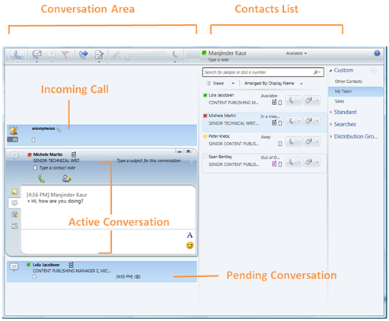
Understanding the Lync Attendant Window
The Attendant window is divided into two main areas; Conversations and Contacts.
Incoming, active and pending conversations are displayed in the Conversation Area.
Incoming Area – The area where new conversations come into Attendant
Active Area – The main window for one conversation, where multiple operations can be performed.
Pending Area – The area where calls on hold or minimized conversations are placed.

Slide 5
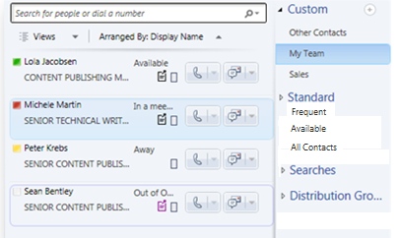
Using the Contacts List
Your Contact List is a list of contacts with whom you communicate most often, shows the availability of your contacts and allows you to view additional contact details by right-clicking the contact’s name, and then clicking Properties.
You can place a phone call, start an instant messaging (IM) session, start an e-mail conversation, or start a conference with any of your contacts.
Attendant includes three standard groups: Frequent, Available, and All Contacts.
  Frequent lists in descending order the names of people with whom you have had recent contact through Lync Attendant.
  Available lists all contacts whose presence does not indicate Away, Unknown, or Offline.
  All Contacts lists all contacts that have been added to your Contact List (except by way of being a member of a Distribution List).
You can also create custom groups to manage your contacts.

Slide 6
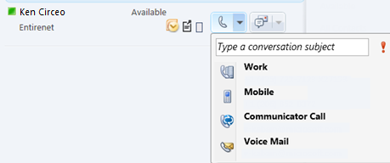
Make a Call and End a Call
To call someone in your Contact List, double-click their name or click the phone button next to their name.
Select one of the options as appropriate. Please note that some of these options may not be variable, depending on how the user has been set up.
  Work number
  Mobile
  Lynch call
  Voice Mail
To end the call, click the End Conversation icon or you can close the conversation window.

Slide 7
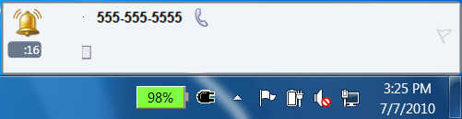

Answer a Call
When you receive a call, a desktop alert appears in the right hand side of the task bar, as well as the Incoming Area.
The alert is displayed when Attendant is minimized or closed while running, and allows you to answer the Call right away and bring the Attendant into the foreground in the process.
To answer a call, double-click the incoming call alert or click Accept.
To decline a call, click Decline. If voice mail is enabled, the call is redirected to your voice mail.
Note: The call alert looks different for a repeat caller. Respond to the call the same way as a normal alert, by double-clicking the alert or by clicking Accept or Decline.
Incoming Call Alert
Accept or Decline the Call

Slide 8
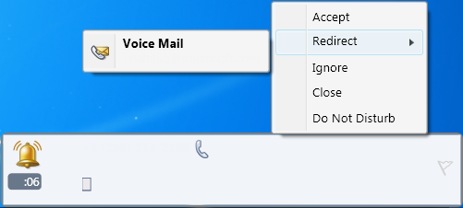
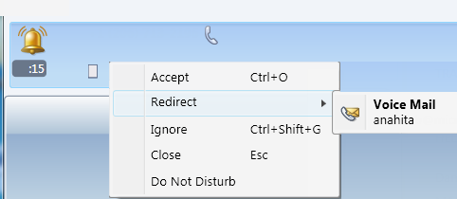
Answer a Call (continued)
  When you receive a call, you have other options that you can chose from as appropriate. Right click the alert and select one of the following options:
  Accept - Connects the call
  Redirect-Voice mail: Redirects the caller to voice mail - which is sent to your email.
  Ignore: Redirects the caller to voicemail.
  Close: Redirects the caller to voicemail and closes any active IM sessions.
  Do not Disturb: Redirects the caller to voicemail and sets your presence to Do Not Disturb. If your status is set to Do Not Disturb, the incoming calls will be directed to your VM automatically.
  Note : These options are variable both with the alert and the active conversation area within the Attendant console.

Slide 9
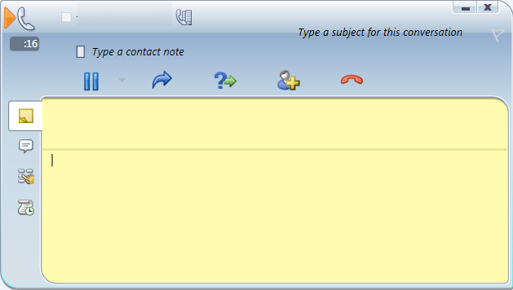
Using the Call Controls
When you've answered a call, it appears in the Active area. Using the call controls, you can perform various tasks, including the following.
  Place the call on hold or park the call
  Transfer the call
  Consult with the intended recipient before you transfer
  Invite someone else to join the call
  End the call (hang up)
Call Controls
Active Conversation Area
Hold
Consult
End
Transfer
Invite

Slide 10
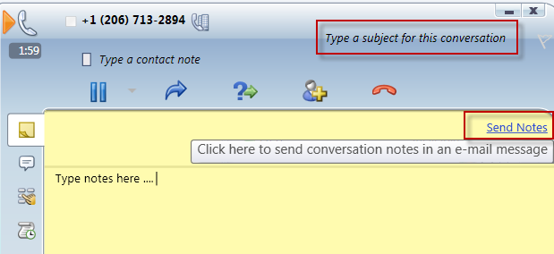
Taking Notes During a Call
You can take notes during a call and send the conversation notes via email.
In the active conversation area, click the Note tab.
Click anywhere in the Note area and type your note.
To send the notes our via email, type a subject for the note by clicking Type a subject for this conversation area. Then click Send Notes.
An email opens with the notes and subject populated.

Slide 11
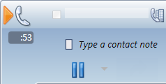
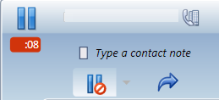

Place a Call on Hold and Transfer a Call
Place a Call on Hold
In the Conversation window, click the Hold icon. The caller will hear hold music and the timer will go off until you resume the call.
Click the Hold button again to resume the call.
Transfer a Call
In the Conversation window, click the Transfer icon.
Double-click the name in the Contact List that you want to transfer the call to. The call disappears from your Conversation window. An unsuccessful transfer displays an error message.
Transfer a call

Slide 12
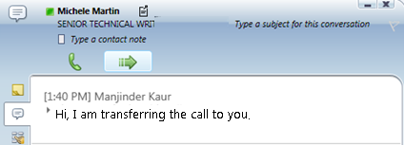
Consult Before Transferring a Call
In the Conversation window, click the Consult before transferring or merging calls button. The call will be placed on hold.
In your Contact List, click the recipient’s phone icon. (Or, click their IM icon to consult by instant messaging.)
If the recipient agrees to take the transfer, click the Call this contact, connect button.
If the transfer is successful, the call simply disappears from your Conversation window. An unsuccessful transfer displays an error message.
If the recipient does not want to take the transfer, end the consultation and then click the Hold/Resume call button to resume the conversation with the caller.

Slide 13
Invite Someone Else to Join the Call
Invite someone else to join the call
To add contacts during a conference call, click the Add icon.
Double-click the contact name or drag the contact from the Contact List into the Conference area.

Slide 14
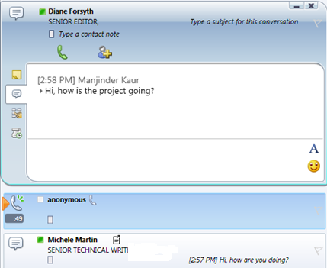
Managing Multiple Conversations
You can use the Conversation area to manage multiple conversations including incoming, active, and pending.
You can maintain multiple active conversations at the same time, but only one voice conversation
at a time.
For example, you can accept an incoming call while you're maintaining two other instant messaging (IM) conversations.
In this case, whichever IM conversation you are addressing at the moment moves to the Active area, and the voice conversation would still be active (indicated by the red arrow) even though it moves to the Pending area on your screen.

Slide 15
Team-Call Group Overview
  The Team Call allows the incoming calls to be forwarded to a defined team.
  When a team-call group receives a call, each member’s phone rings, and all members can see who forwarded the call.
  When a team member answers the call, the phones of all other members stop ringing.
  Team Call feature is helpful if you are part of a group of people who share responsibility for a particular area, for example HR team or Admin team.
  You can set up this feature to ring you and your team-call group simultaneously, or you can set a delay so that your calls ring you first and then your team-call group after a specified number of seconds.

Slide 16

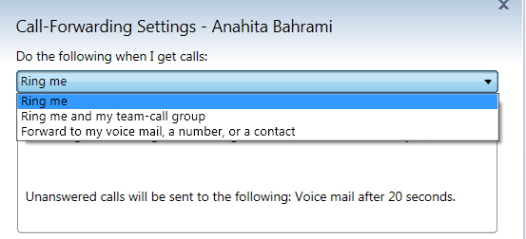
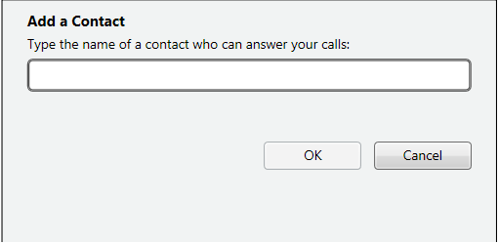
Set up the Team-Call Group
  Set up the Team Call:
  Click View or Change Call-forwarding settings on the toolbar.
  When the Call-Forwarding Settings window opens, click Ring me and my team-call group, on the Do the following when I get calls drop-down menu.
  Under Add team-call group members to answer calls on your behalf, click Add.
  Type the name of a contact that can answer your calls, and then click OK.

Slide 17
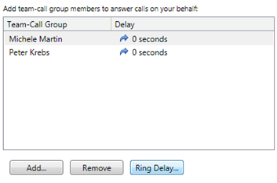
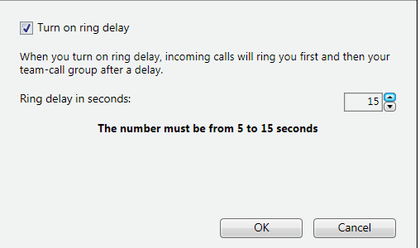
Set a Ring Delay
  When enable team-call, it is import to set a ring delay. When you turn on a ring delay, incoming calls will ring you first and then your team-call group, after a delay.
  To set a ring delay:
  Click on one of your contacts, then click Ring Delay.
Check the Turn on ring delay check box, and then set the ring delay time and click OK.
Click OK again to save and apply the settings.

Slide 18

Answering Calls for a Response Group
  As a response group agent, you’ve been selected to help answer phone calls for a group or for multiple groups. You can use Attendant to answer and manage the phone calls that come into your group.
  When the Response Group Manager makes you an agent for a response group, you’ll see an alert in Lync Attendant that tells you to which group you’ve been added. When you’re signed into a group, you’re ready to take a call. If it is a formal sign in group, the user must sign in using a web page that shows the groups they are part of). If it is an informal group, you can automatically receive calls once you sign in.
  NOTE: If the privacy policy is enabled on the server, then you must search for the RGS contact and add them to your contact list to receive calls.
  An incoming call alert will show you which group is routing the call to you.
  Click the alert to answer the call.
Alert

Slide 19
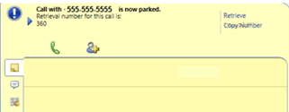

Parking a Call
  Instead of putting a call on hold, you can park the call in a holding queue.
  Park the Call
  Click the Hold menu.
  Click Park call. When the call is successfully parked, you get a notification with the retrieval number. Communicate the retrieval number to the person or department that the call is being transferred to.
  Retrieve the Call
  Type the retrieval number in the search box to retrieve the call.
  You are then notified the call has been retrieved.
1
2
Retrieval Number
Park the call

Slide 20
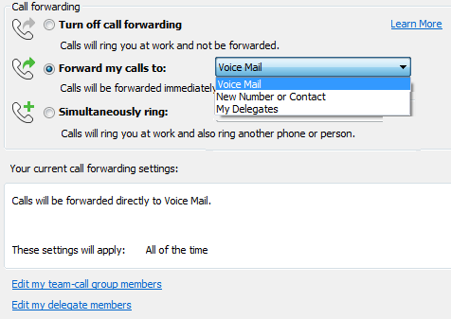
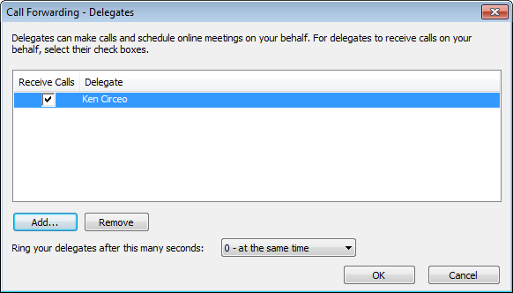
Make Calls for Someone Else
  Assistants can receive and make calls on behalf of their managers using the Attendant console. Boss/Admin is an option in the Call-Forwarding Settings.
  The following steps must be performed by the manager to select a delegate:
  Open Lync, click the Options button, click Tools and then click Call-Forwarding Settings.
  Click Edit my delegate members , then Add to select the delegates
  Note: All incoming calls will ring the delegate specified.
  In the Call Forwarding section, click My Delegates.
Forward Calls to Delegates
Edit Delegates
Add Delegates

Slide 21
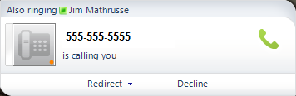
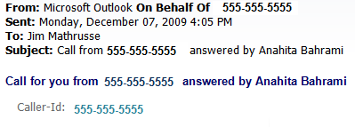
How Delegating your Calls Works
  The delegate receives a notification in Lync Attendant and the Lync Client and answers the call.
  An email is also sent to the boss with information about the call

Slide 22

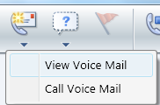
Check Voicemail
  You are notified when you have a new voice mail.
  Check your voicemail:
  Click the Voice Mail menu on the toolbar.
  View your voicemails in Outlook:
  Click View Voice Mail. You can see your Voicemail preview in an Outlook message.
  Listen to your voicemail:
  Click Call Voice Mail. You connect to voicemail and hear options to listen to your message, delete, forward.

Slide 23
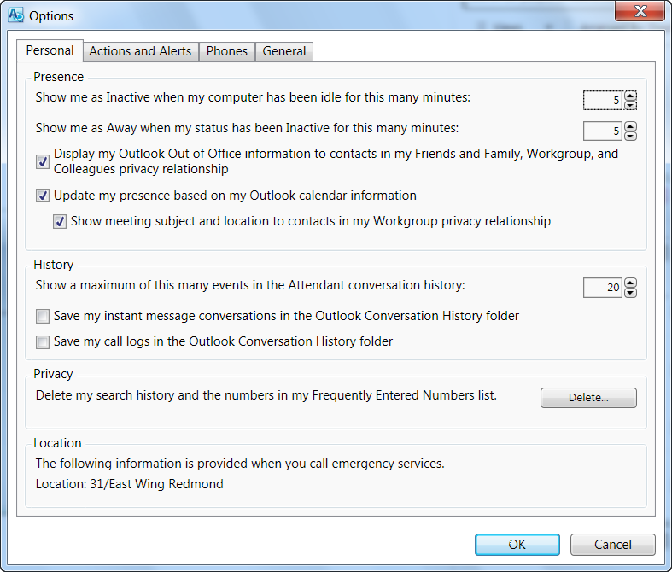
Lync 2010 Attendant Options
  Change Attendant options:
  Click the Options button on the Toolbar, and then click Options.
  On the Options window, customize settings, such as Presence, History, Alerts, Phone numbers, Application settings, sounds, etc.

Slide 24
Review Activity
  Complete the following activities:
Use the Contacts List to find a contact.
Make a call.
Take notes on a call.
Use Call Controls to put a call on hold.
Consult and connect the call with someone else.
Transfer a call.
Add someone to a Team-Call Group.

Slide 25
Review
  This course covered the following Lync Attendant features:
Using the Contacts List
Understanding Call Controls
Making and Receiving Calls
Managing Multiple Conversations
Setting up Team-Call Groups
How to Park and Retrieve Calls

Slide 26


© 2010 Microsoft Corporation. All rights reserved. Microsoft, Exchange ActiveSync, Excel, Lync, Outlook, PowerPoint, SharePoint, SQL Server, Windows, Windows Live, Windows Mobile, Windows Server, and other product names are or may be registered trademarks and/or trademarks in the United States and/or other countries/regions. The information herein is for informational purposes only and represents the current view of Microsoft Corporation as of the date of this presentation. Because Microsoft must respond to changing market conditions, it should not be interpreted to be a commitment on the part of Microsoft, and Microsoft cannot guarantee the accuracy of any information provided after the date of this presentation. MICROSOFT MAKES NO WARRANTIES, EXPRESS, IMPLIED OR STATUTORY, AS TO THE INFORMATION IN THIS PRESENTATION.
BACK TO OBJECTIVES

